Slide 1

AI-Powered Creative Writing Assistant

Slide 2
Brief Description of the Problem Being Solved
Many aspiring writers struggle with generating original ideas, structuring stories, or maintaining consistent writing quality. Writer’s block, lack of inspiration, and difficulty refining drafts are common obstacles. Additionally, beginners often lack access to creative guidance or tools that help them improve their narrative skills. This creates a gap where users need an accessible, intelligent assistant that can support creativity, offer suggestions, and help them refine their writing in real time.
Overview of the Proposed Solution (High-Level Idea)
The proposed solution is an AI-Powered Creative Writing Assistant, built in Python using natural language processing techniques. The system allows users to input a topic or idea and receive creative prompts, story outlines, character suggestions, and writing enhancements. It interacts with users through an intuitive interface and provides real-time feedback on grammar, tone, and structure. By leveraging AI text-generation models, the assistant acts as a smart co-writer that helps users brainstorm, expand their ideas, and polish their writing.
Unique Value Proposition
What makes this project stand out is its combination of creativity support and intelligent writing enhancement in one integrated tool. Unlike typical grammar checkers or simple prompt generators, this assistant:
Offers end-to-end creative support — from idea generation to final draft refinement.
Provides customizable writing outputs, tailored to genre, tone, and creativity level.
Helps users both learn and create, improving their writing skills while assisting in real-time.
Is developed in Python, making it lightweight, flexible, and easy to extend for educational or research use.
This unique blend of creativity, personalization, and AI-driven assistance makes the project especially valuable for students, new writers, and anyone seeking a smart tool to enhance their storytelling abilities.

Slide 3
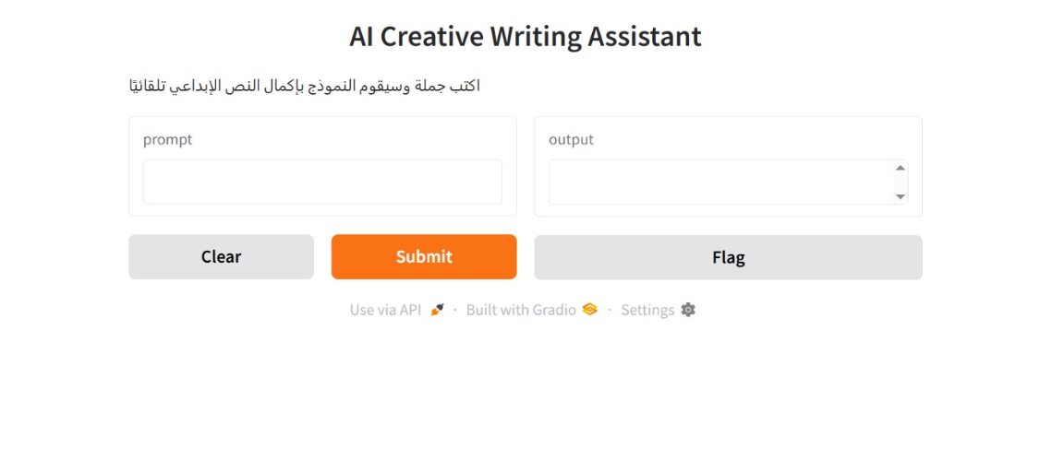
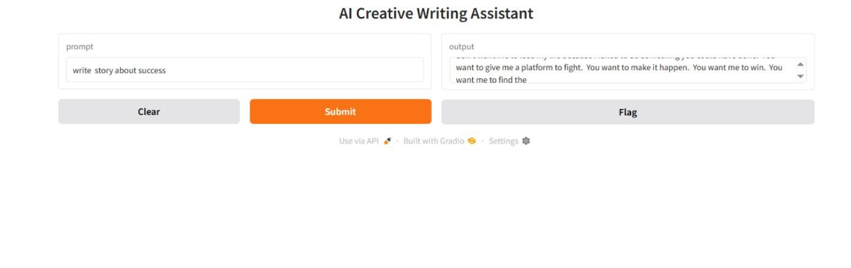
key user interfaces:

Slide 4
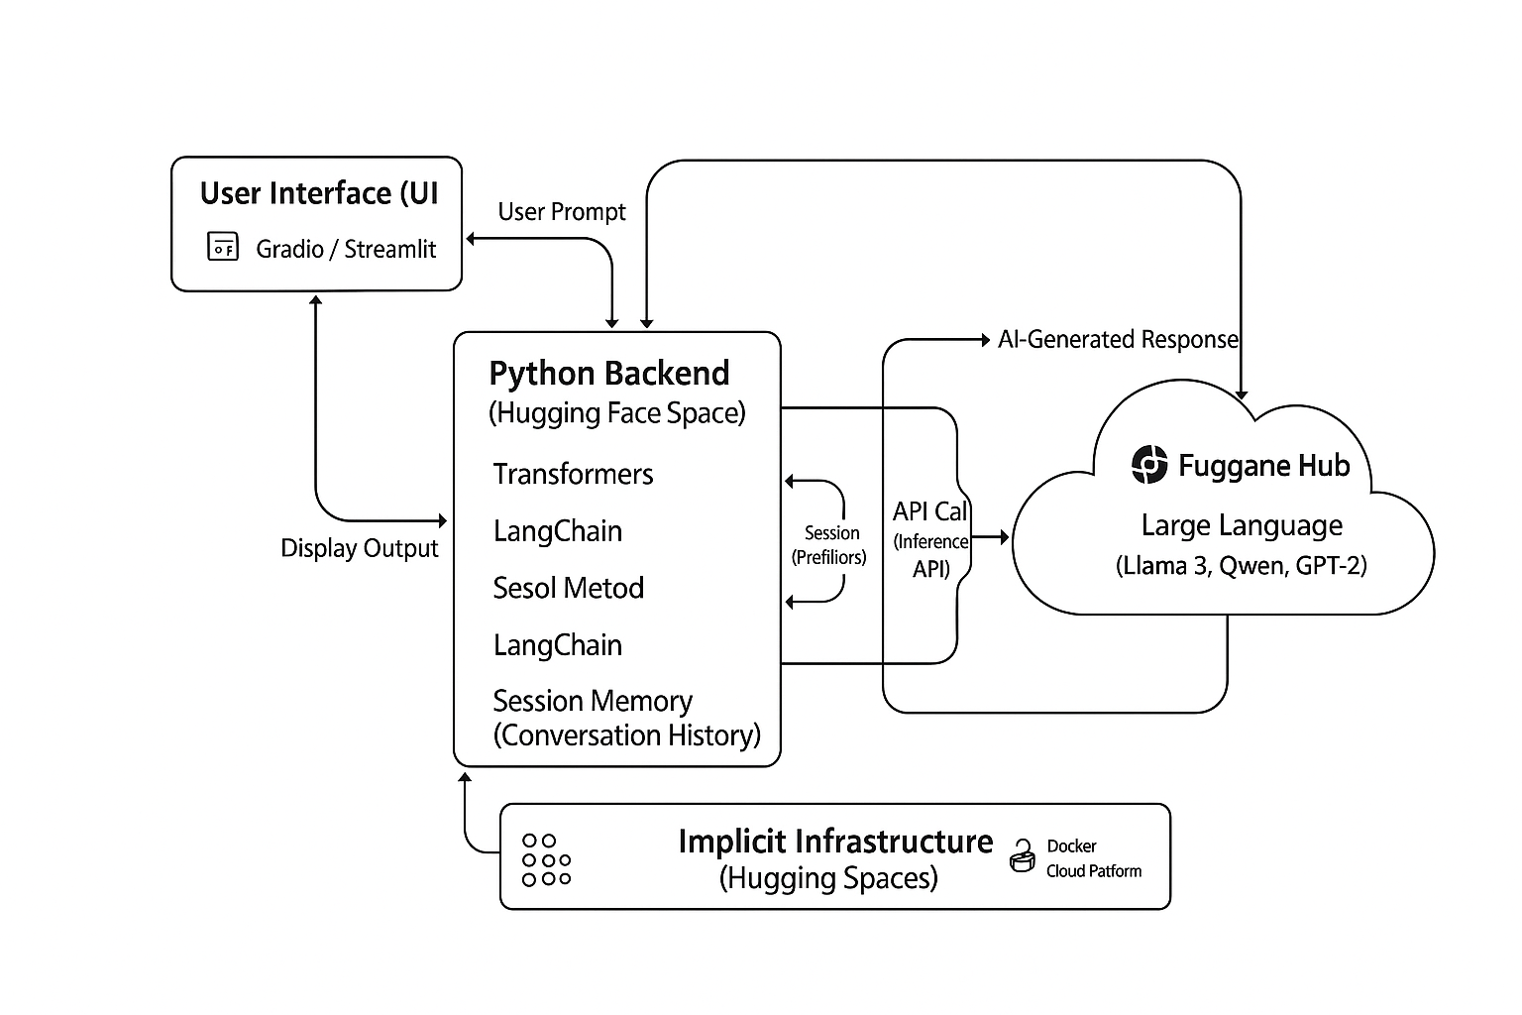
Overview of User Journey
1. Onboarding / First Interaction
User lands on the assistant’s page (e.g., Hugging Face Space).
Quick intro or example prompts show what the tool does.
User enters their first prompt (story idea, paragraph, or question).
Assistant generates immediate output → “first value moment.”
User tries different prompt types (story generation, rewriting, expansion).
Learns what the assistant can do through examples or trial-and-error.
Begins adjusting tone, style, or length through prompts.

Slide 5
Primary User Personas
1. Aspiring Writers / Students
Users who enjoy writing but struggle with generating ideas, structuring stories, or maintaining consistent quality. They need guidance, inspiration, and supportive tools to improve their writing skills.
2. Content Creators / Bloggers
Users who frequently create written content for social media, blogs, or online platforms. They need rapid content generation, rewriting assistance, and stylistic flexibility.
3. Educators / Writing Coaches
Teachers or mentors who guide students in writing exercises. They need tools that help demonstrate writing techniques, generate prompts, and support learning.
4. Creative Hobbyists
Users who write for fun and want a playful, creative tool to brainstorm stories, characters, and ideas without pressure or strict structure.
How the Features Solve Each End-User’s Problems
Aspiring Writers / Students benefit from AI-generated ideas, structured plot guidance, and grammar improvements, helping them overcome writer’s block, learn better writing techniques, and gain confidence through real-time support.
Content Creators / Bloggers get fast, tailored content through tone adjustment, rewrite/expansion tools, and customizable outputs, enabling them to maintain consistent style and produce polished material quickly.
Educators / Writing Coaches use prompt generation, character/world-building tools, and real-time assistance to create engaging writing exercises, demonstrate storytelling concepts, and support student practice.
Creative Hobbyists enjoy creative prompts, playful world-building features, and high-creativity modes that inspire imagination, offering a flexible and fun writing experience without strict structure.

Slide 6
Key Features That Address User Needs
Idea & Prompt Generation
Character and World-Building Tools
Plot & Story Structure Generation
Grammar and Style Enhancement
Tone and Style Adjustment
Real-Time Interactive Writing Assistance
Customizable Output (genre, creativity level, writing length)
Rewrite & Expand Text Options

Slide 7
Data Structure:
Description of the Database Architecture: The application likely uses a stateless or in-memory architecture.
There is typically no persistent database (relational or non-relational) for simple AI assistants hosted on Hugging Face Spaces. Conversation history, if maintained, is stored temporarily in the application's session memory (e.g., a list of dictionaries in a Python variable).
Key Entities and RelationshipsKey Entities:User Prompt (Input): The text provided by the user (e.g., "Write a story about a brave knight").LLM (Large Language Model): The external entity that performs the creative writing (e.g., Meta Llama 3, Qwen).AI-Generated Response (Output): The creative text returned by the LLM.Conversation History: The sequence of previous User Prompts and AI Responses (if chat functionality is included).Relationships:User Prompt $\rightarrow$ LLM (Request/Input)LLM $\rightarrow$ AI-Generated Response (Response/Output)Conversation History is composed of a sequence of User Prompts and AI-Generated Responses.
Data FlowThe data flow is a sequential Request-Response cycle:Collection: The user enters a User Prompt into the Gradio/Streamlit UI.Processing & Storage (Temporary): The Python backend code receives the input. It may append the prompt to the current Conversation History list (in memory) and format the entire history into a single structured prompt for the LLM.Access: The backend sends the formatted prompt (a string of data) via an API call (e.g., to the Hugging Face Inference API).Generation: The remote LLM processes the data and generates the AI-Generated Response.Output: The backend receives the response and streams or displays it to the user via the UI. The cycle then repeats.

Slide 8
Programming Languages & Frameworks:
Python: The primary language used for the backend logic, handling the user interface (UI) components, prompt processing, and calling the Large Language Model (LLM).HTML/CSS/JavaScript: Used indirectly for the front-end interface, as the chosen framework (Gradio or Streamlit) renders these components automatically.
Frameworks/Tools Used Gradio or Streamlit: One of these is almost certainly the UI framework (SDK) used to quickly create the web interface and deploy it on Hugging Face Spaces.Hugging Face transformers / huggingface_hub: Core libraries used for accessing and interacting with pre-trained Large Language Models (LLMs) hosted on the Hugging Face Hub.LangChain (or similar library): Often used for orchestrating the LLM calls, managing prompts, and handling conversational history.
Supporting TechnologiesCloud Platform: Hugging Face Spaces (hosting and execution environment).APIs: Hugging Face Inference API (used to send user prompts to a powerful remote LLM and receive the generated text). The application is likely consuming a Model as a Service.Containerization: The platform implicitly uses Docker to containerize and run the Python application based on the chosen SDK (Gradio/Streamlit).

Slide 9
Key testing phases:
AI Powered Creative writing assistant is now live and giving the application purpose which is supporting writing purposes after many testing phases
Unit Testing
Test individual functions and components.
prompt processing, model call function, UI elements, error handling.
Integration Testing
Test how components work together.
UI → model → output flow, model loading, API interactions, overall inference pipeline.
User Testing
Test the full experience with real users.
usability, clarity, response quality, performance, ease of completing writing tasks.
Testing Phase | Purpose | What is Tested
Unit Testing | Validate individual components | Functions, UI elements, text-processing logic
Integration Testing | Ensure components work together | UI ↔ model interaction, backend inference, environment setup
User Testing | Evaluate real-world usability & output quality | User flow, clarity, content quality, performance

Slide 10
Deliverables:
User Manual:
- Introduction
The Creative Writing Assistant is an AI-powered tool that helps users generate, improve, and explore creative writing.
You can write stories, expand ideas, rewrite paragraphs, or brainstorm new concepts by simply entering prompts.
- Accessing the Application
Go to the Hugging Face Space:
Creative Writing Assistant (https://huggingface.co/spaces/Fatma5shawqy/creative-writing-assistant).
Wait for the app to load (a “Running” badge indicates it is ready).
- Interface Overview
The interface typically includes:
Text Input Box – where you write your prompt or paste text.
Generate / Submit Button – sends your request to the AI model.
Output Area – displays AI-generated results.

Slide 11
Timeline For Deliverables:
Week | Phase | Description
Week 1 | Planning | Define requirements, user journey, and architecture
Week 2 | Design | Create UI/UX wireframes and technical design
Weeks 3–4 | Development | Week 3: Build backend + model integrationWeek 4: Build frontend UI
Week 5 | Integration | Connect frontend and backend; implement core features
Week 6 | Testing | Unit testing, integration testing, user testing
Week 7 | Deployment | Deploy to Hugging Face; add documentation
Week 8 | Final Launch | Final QA, fixes, and release

Slide 12
AI-Powered Creative Writing Assistant
https://huggingface.co/spaces/Fatma5shawqy/creative-writing-assistant
Hosam Eldein Mohamed Elsheshtawy
Team Leader
Alaa Taha EL Maria
MI Engineer
Fatma Shawky Mohamed Elhely
Developer
Yasser Ahmed Shawky
Development & training
Mohamed Mohamed Abdelkawy
MOLOPS
Eslam Ragab Kamal
Tester

Slide 13
Thank You
Feel Free to ask

